Slide 1
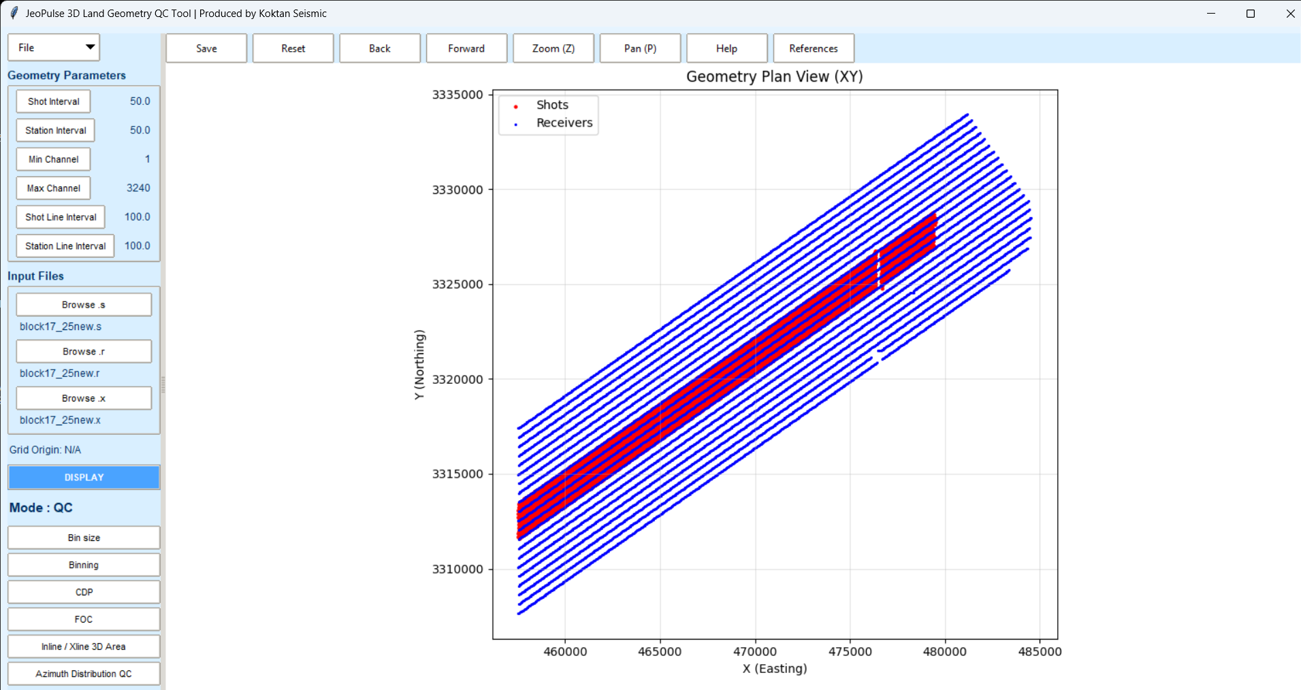
What JeoPulse brings to a survey team
JeoPulse converts SEG-SPS inputs into visual, trace-based 3D acquisition QC that both technical and commercial stakeholders can understand.
•
Trust the geometry
Reads shot, receiver, and relation files directly and rebuilds true survey relationships for credible QC.
•
See the risk early
Makes survey footprint, coverage balance, fold concentration, and directional behavior visible before field issues become costly.
•
Speak one QC language
Gives acquisition, processing, and tender teams a shared visual reference for faster decisions and cleaner handovers.
True geometry plan view
JeoPulse | Customer Preview
2
Notes:
[Sources]
- User-provided source deck: JeoPulse_3D_Seismic_Acquisition_Geometry_QC_Preview_Summary.pptx (media image2 reused).
- Claims summarized from the uploaded source deck sections describing SEG-SPS inputs, true shot–receiver relationships, and 3D QC outputs.

Slide 2
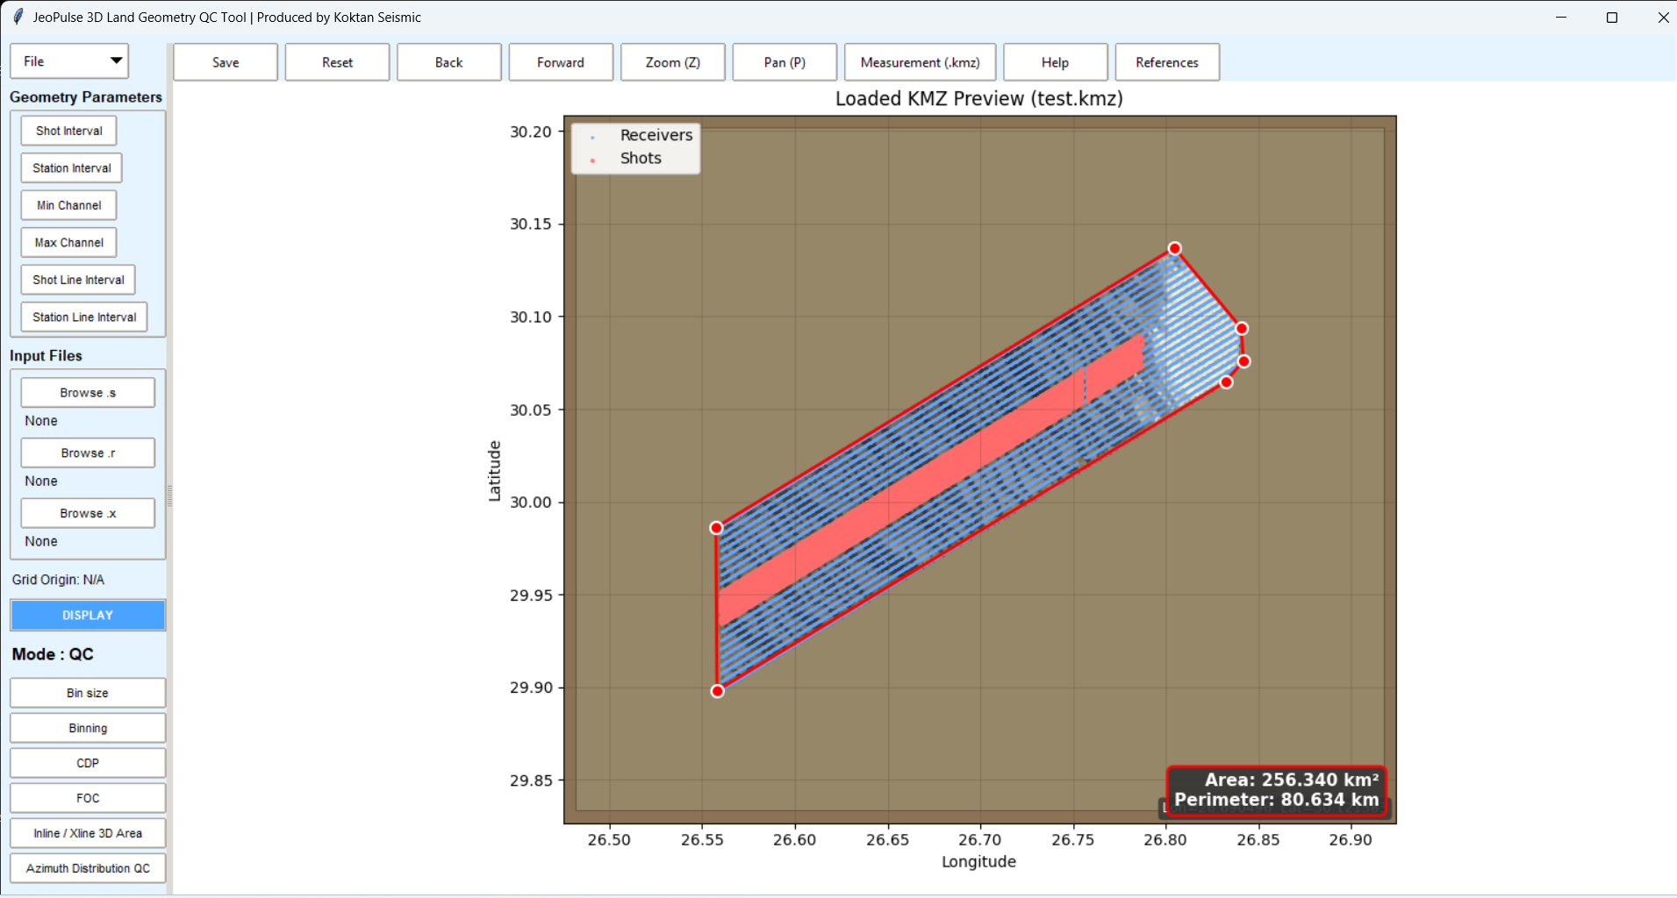
Boundary validation that is easy to explain to customers
A KMZ-backed map view turns survey geometry into a business-friendly proof point.
Why this matters commercially
• Confirms the active receiver and shot layout against the planned survey boundary.
• Instantly surfaces footprint size, perimeter, edge effects, and coverage confidence in one view.
• Supports planning discussions, tender clarifications, and customer reporting with spatial metrics that are easy to verify.
• Reduces manual interpretation by combining map visualization with automatic area and perimeter calculation.
Customer message:
“Your survey footprint, acquisition layout, and survey metrics can be checked in seconds — not buried in a spreadsheet.”
JeoPulse | Customer Preview
3
Notes:
[Sources]
- User-provided source deck: JeoPulse_3D_Seismic_Acquisition_Geometry_QC_Preview_Summary.pptx (media image3 reused).
- Slide narrative based on the uploaded source deck’s KMZ-based 3D geometry QC preview text.

Slide 3
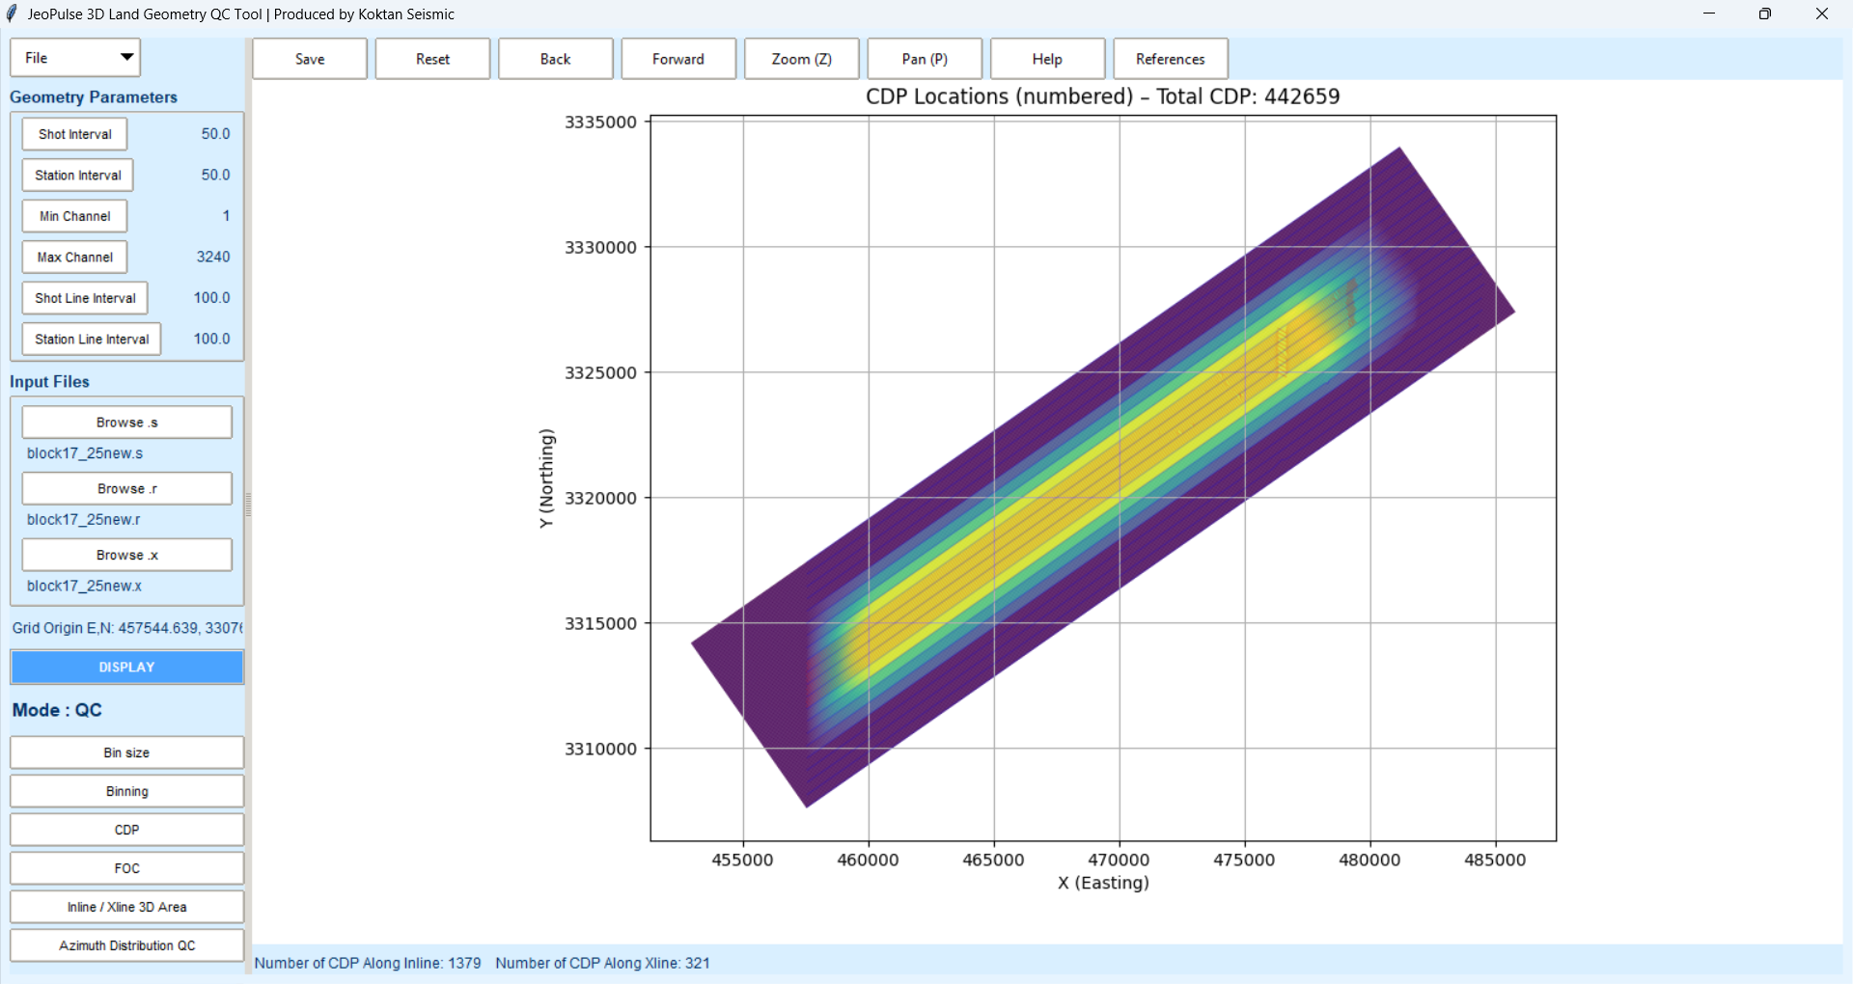
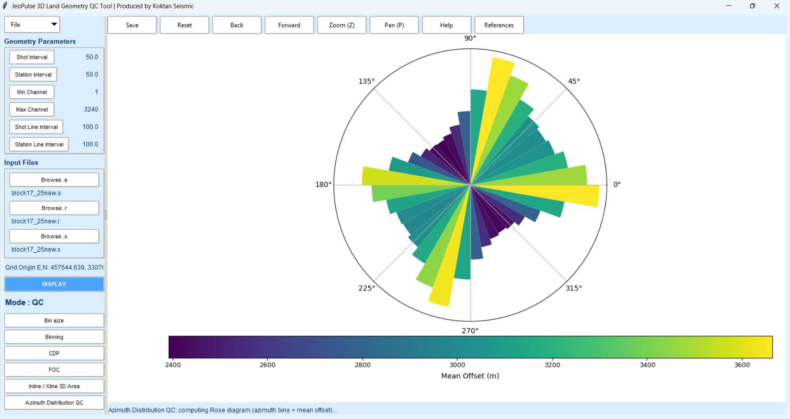
From raw SPS triplets to decision-ready QC
The core workflow is short, logical, and built to keep engineering detail visible without slowing the review process.
1
Read SPS geometry
2
Build bins & CDPs
3
Validate acquisition quality
Shot, receiver, and relation files are aligned into a coherent survey layout.
→
Grid logic creates binning, inline / crossline references, and CDP numbering.
→
Fold, coverage, offset behavior, and azimuth distribution become immediately visible.
Survey layout
CDP / bin numbering
Azimuth distribution
JeoPulse | Customer Preview
4
Notes:
[Sources]
- User-provided source deck: JeoPulse_3D_Seismic_Acquisition_Geometry_QC_Preview_Summary.pptx (media images2, 4, and 6 reused).
- Workflow and QC steps summarized from the uploaded source deck overview and workflow slides.

Slide 4
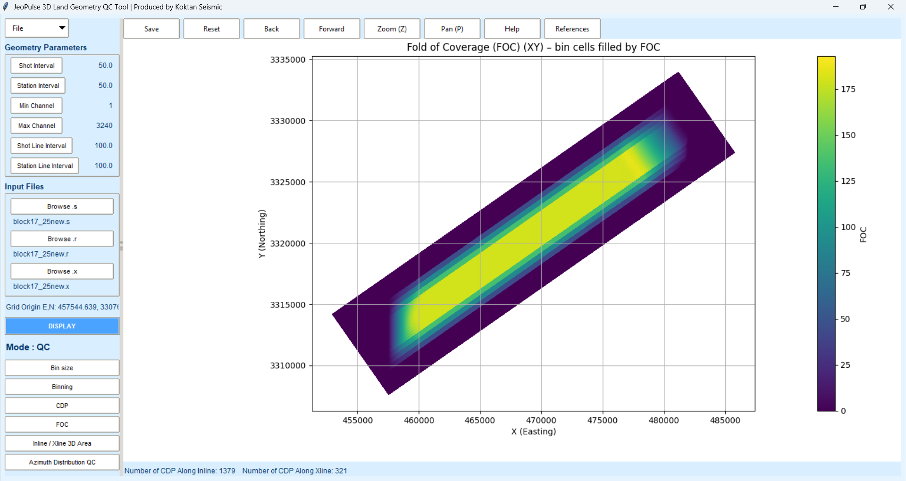
QC outputs customers can grasp immediately
The strongest sales story is not every feature — it is what the software reveals at a glance.
Fold of Coverage
Azimuth & Offset Rose
CDP / Bin View
Trace-based fold cells make gaps, concentration, and uniformity visible in seconds. A fast way to discuss data confidence before acquisition progresses.
Directional balance and mean offset can be reviewed together, helping teams judge acquisition symmetry and layout quality.
Automatic numbering and bin logic provide a clean spatial reference for QC review, technical alignment, and downstream processing handover.
JeoPulse | Customer Preview
5
Notes:
[Sources]
- User-provided source deck: JeoPulse_3D_Seismic_Acquisition_Geometry_QC_Preview_Summary.pptx (media images4, 5, and 6 reused).
- Narrative derived from the uploaded source deck sections on fold of coverage, azimuth distribution, and QC visuals.

Slide 5
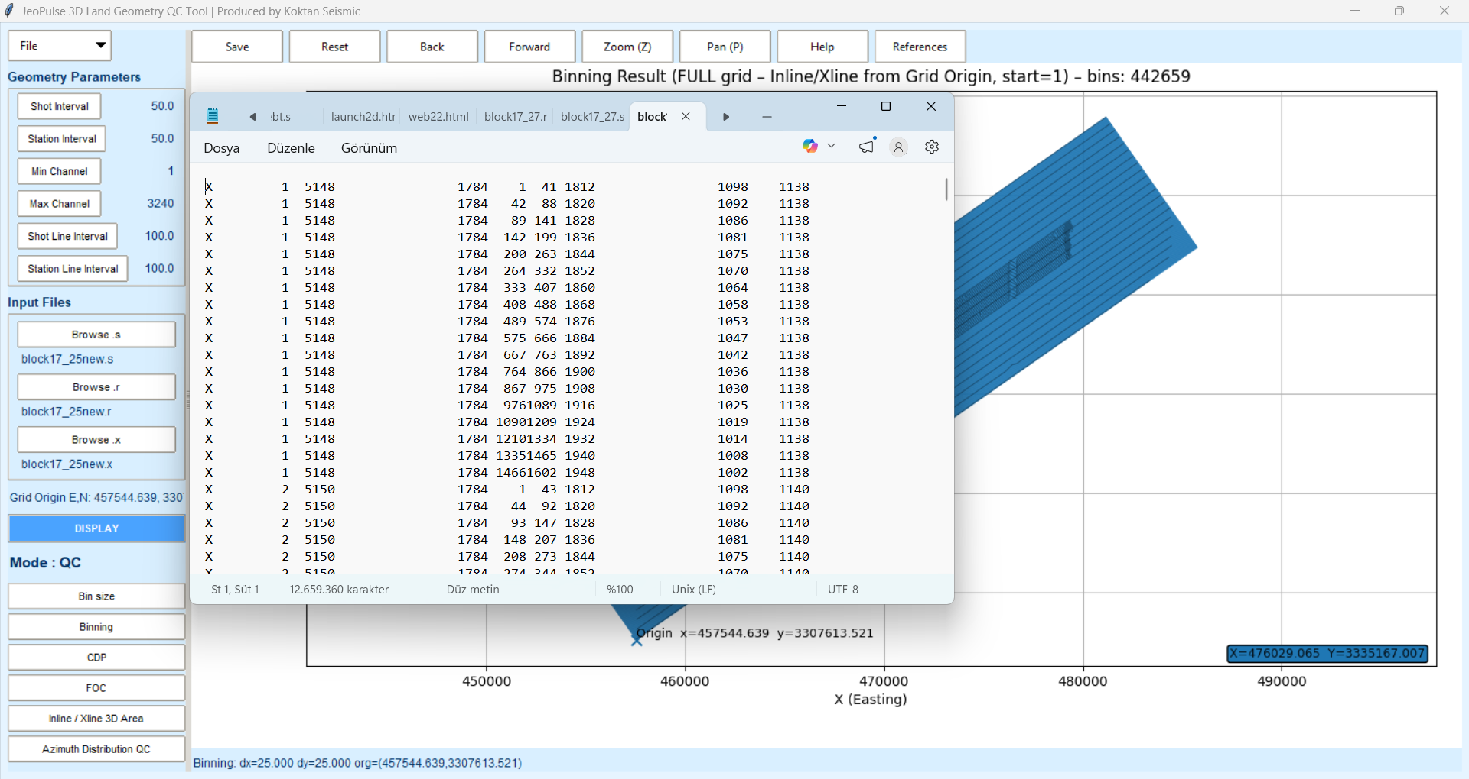
Why this deck now sells better
The technical core stays intact, but the story is sharper for a customer-facing review.
What customers can now take away
• Purpose-built for 3D land seismic acquisition geometry QC.
• Combines import, calculation, plotting, and export in one desktop workflow.
• Makes boundary validation and acquisition quality visible in a presentation-friendly way.
• Supports business conversations as well as engineering review.
Export-ready evidence
Generated outputs stay reviewable inside the application window, making it easier to move from QC insight to deliverable generation.
Recommended next use: customer preview, tender discussion, internal alignment, or a guided demo call.
JeoPulse | Customer Preview
6
Notes:
[Sources]
- User-provided source deck: JeoPulse_3D_Seismic_Acquisition_Geometry_QC_Preview_Summary.pptx (media image7 reused).
- Closing summary distilled from the uploaded source deck’s concluding customer preview points.

