Slide 1
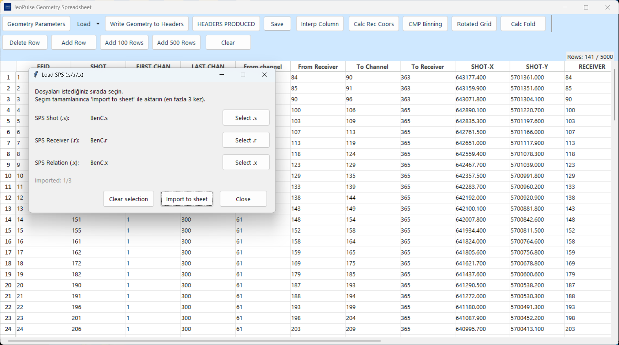
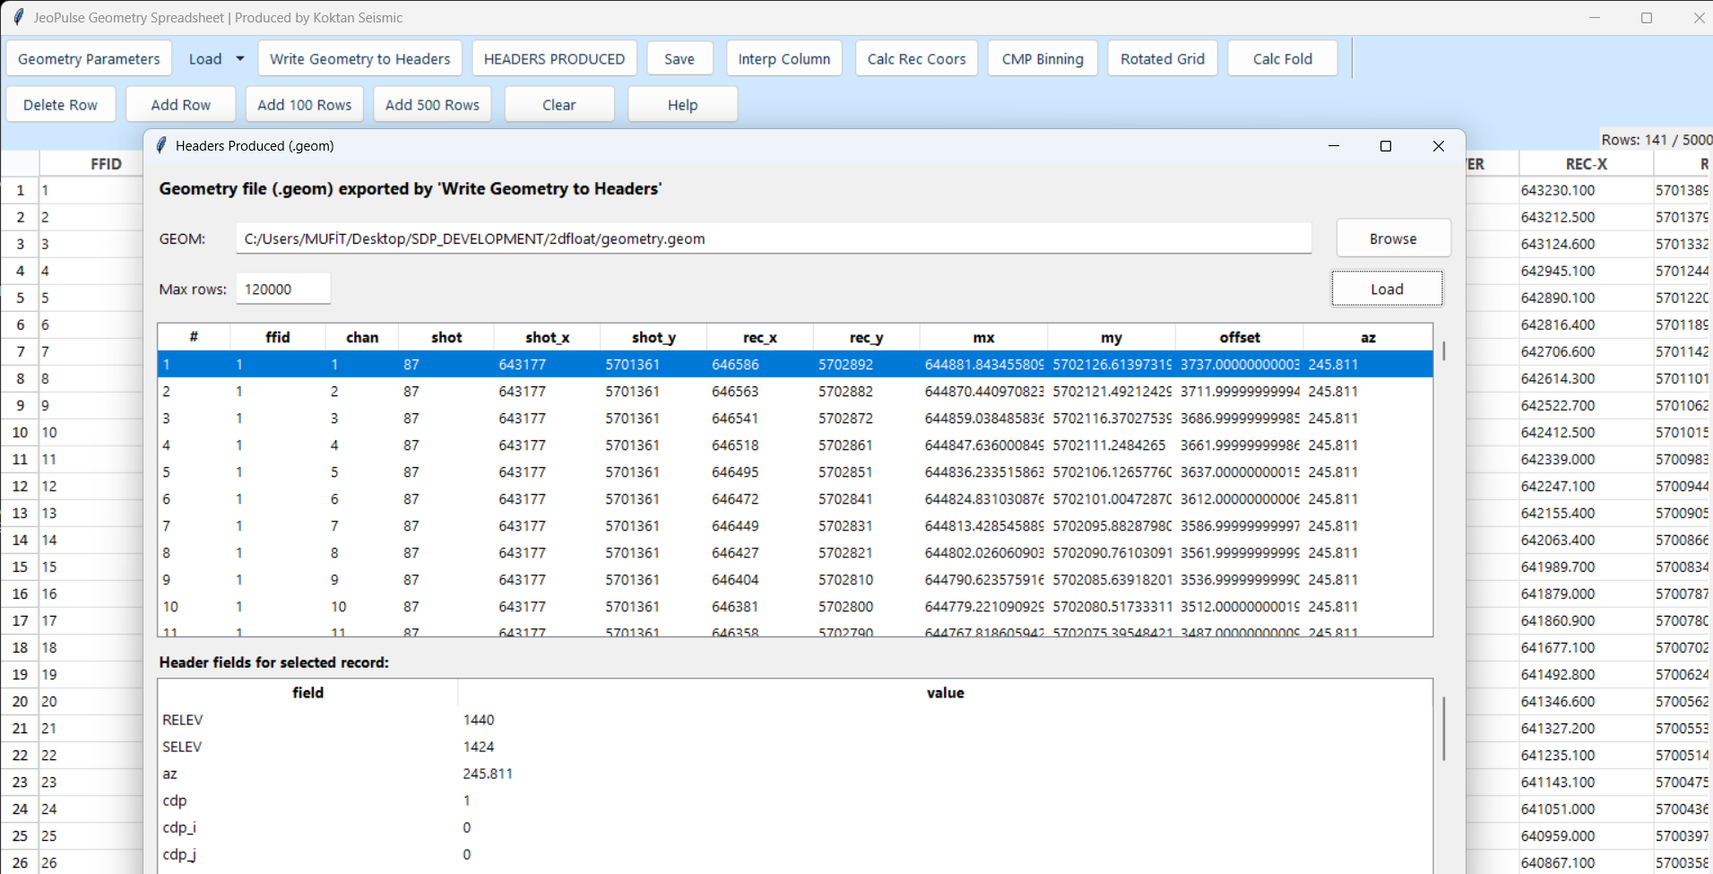
What JeoPulse Delivers
A focused desktop workflow for building, QC’ing, and exporting 2D land geometry.
Spreadsheet-style editing for shot, receiver, channel, station, and elevation data
SPS import with editable fixed-column mapping for .s / .r / .x records
One-click path to receiver coordinate calculation, CMP binning, rotated-grid QC, and fold analysis
Geometry outputs including GEOM ASCII and reviewable header fields
Current UI snapshot
Output review snapshot
The toolbar exposes loading, saving, geometry setup, receiver coordinate calculation, CMP binning, rotated-grid plotting, fold calculation, and header export in one workspace.
Notes:
[Sources]
- User-provided screenshots: /mnt/data/slayt2.png, /mnt/data/slayt7.png
- User-provided code/help text: /mnt/data/2dgeomQC_final_recstn_fixed_v2_no_cdpij.py

Slide 2
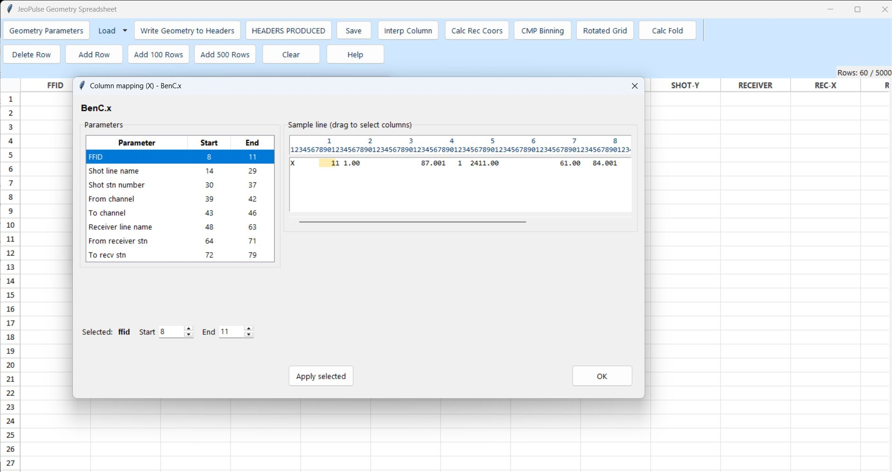
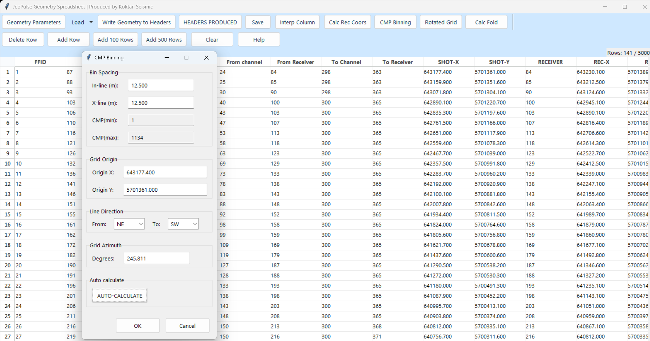
Import and Parameter Setup
The application reduces setup friction before any QC begins.
1. Select SPS files
3. Set geometry + binning
2. Map columns per file
Shot (.s), receiver (.r), and relation (.x) files can be selected and imported into the sheet.
Default fixed-column ranges are prefilled, while users can drag-select or edit start/end positions for each SPS field.
Geometry parameters, grid origin, line direction, azimuth, and auto-calculate options are available from the main toolbar.
Notes:
[Sources]
- User-provided screenshots: /mnt/data/slayt2.png, /mnt/data/slayt3.jpeg, /mnt/data/slayt4.png
- User-provided code/help text: /mnt/data/2dgeomQC_final_recstn_fixed_v2_no_cdpij.py

Slide 3
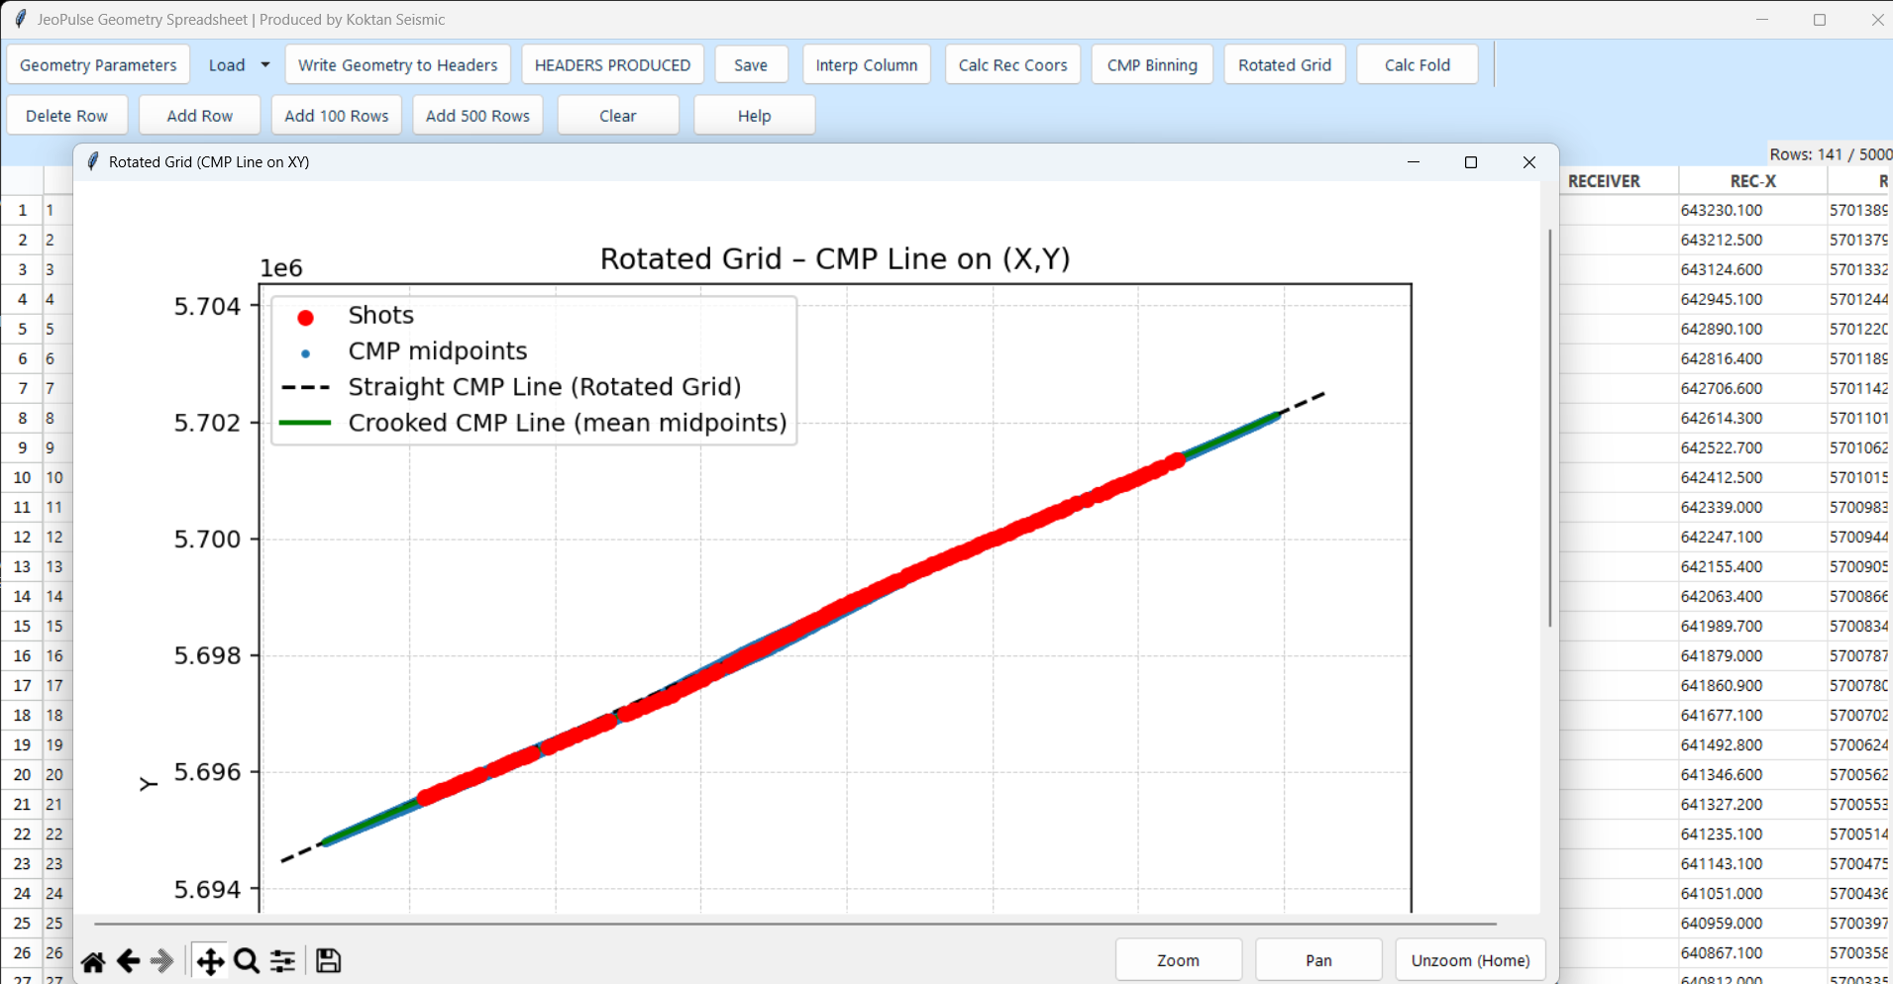
QC Visuals Built for Line Geometry
JeoPulse adds immediate visual feedback to the spreadsheet workflow.
Rotated Grid QC view
Why it matters
Confirms whether the acquisition line behaves as a straight or crooked geometry
Visualizes shots, CMP midpoints, a straight rotated-grid reference line, and the crooked CMP centerline
Provides a quick pre-processing QC step before downstream geometry delivery
Supports zoom and pan for closer inspection
Version highlight
The current code introduces crooked CMP binning based on real midpoint distribution, while keeping the straight rotated-grid line as a reference.
Notes:
[Sources]
- User-provided screenshot: /mnt/data/slayt5.png
- User-provided code/help text: /mnt/data/2dgeomQC_final_recstn_fixed_v2_no_cdpij.py

Slide 4
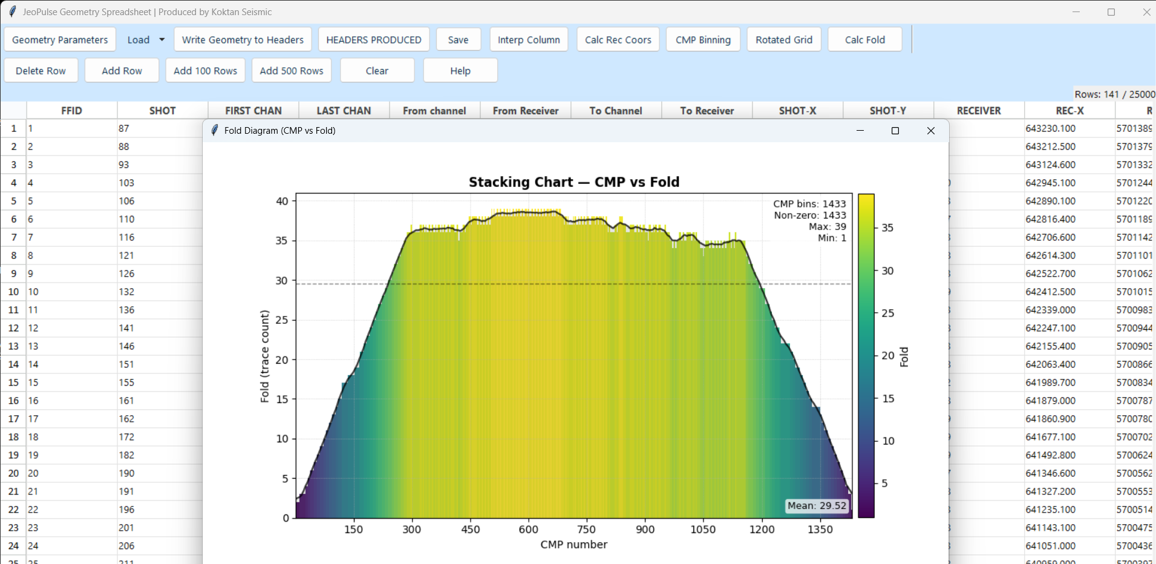
Fold Analysis and Exportable Outputs
Beyond visualization, the tool turns geometry into usable deliverables.
Header-ready export view
Fold diagnostics
Displays CMP bins, non-zero bins, and min / max / mean fold in one chart
Writes geometry to header-oriented outputs and supports GEOM ASCII export
Includes shot, receiver, midpoint, offset, azimuth, and CMP information
Keeps generated output reviewable inside the same application window
Notes:
[Sources]
- User-provided screenshots: /mnt/data/slayt6.png, /mnt/data/slayt7.png
- User-provided code/help text: /mnt/data/2dgeomQC_final_recstn_fixed_v2_no_cdpij.py

Slide 5
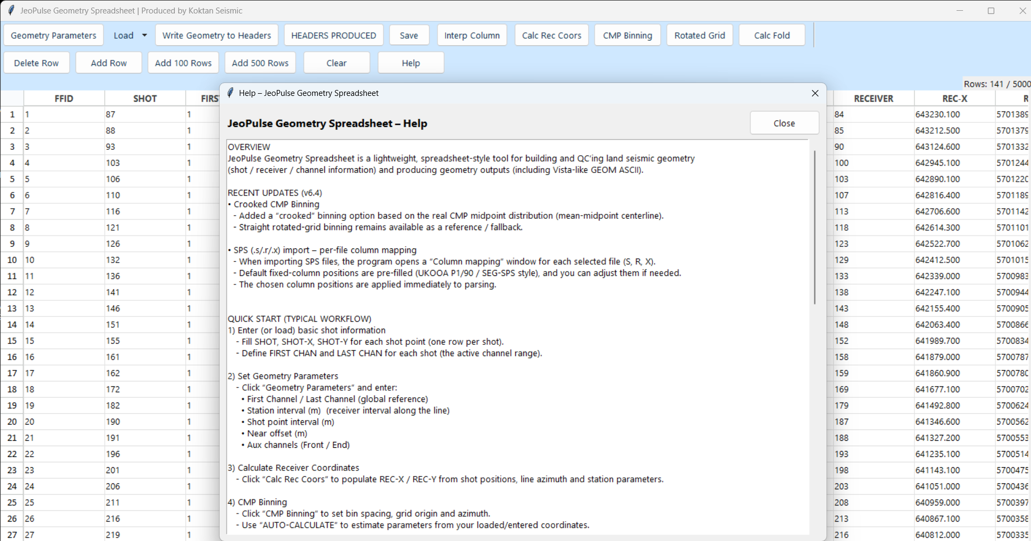
Customer Preview Summary
What a customer can expect from the current JeoPulse build.
Help view
Purpose-built for 2D land seismic acquisition geometry QC
Combines import, editing, calculation, plotting, and export in one desktop tool
Adds customer-visible differentiators such as per-file SPS mapping and crooked CMP binning
Already includes an English help view that supports onboarding and trial demos
Notes:
[Sources]
- User-provided screenshot: /mnt/data/slayt8.png
- User-provided code/help text: /mnt/data/2dgeomQC_final_recstn_fixed_v2_no_cdpij.py

